Slide 1
Digital Signal Processing
(해당 강의자료의 배포 및 무단 복제를 금함)
1) Noise removal
2) Centralized Convolution: Filtering 2D image
Prof. Yung-Lyul Lee (이영렬 교수)

Slide 2
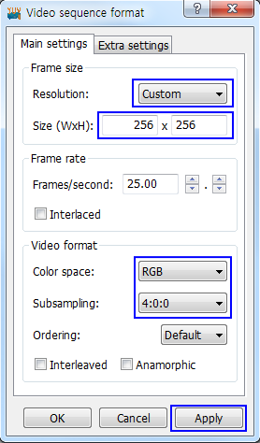
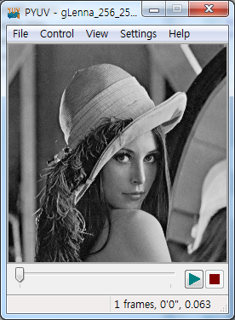
pYUV로 bitmap file 생성가능
다운로드 경로
http://dsplab.diei.unipg.it/~baruffa/dvbt/binaries/player/win32/

Slide 3
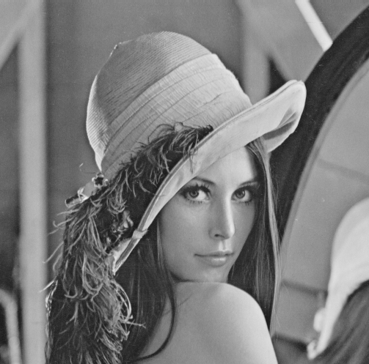
lena.img
512
512 x 512 (pixel by pixel size)
= 262,144 Bytes
Grey level image
8 bits range/pixel
512

Slide 4
512x512 = 262,144 samples
bytes
1D: sample
2D: pixel or sample
3D: voxel
8 x 512 x 512 = 2,097,152 bits ( 262,144 byte )

Slide 5

Pixels in Lana image

Slide 6

Lena 밝기 표현 방법(gray level)
255
0~255
8bit/pixel
0000 0000 ~ 1111 1111
unsigned char
128
ex>
20
91
145
0

Slide 7
Signal !?!?
0 1 2 3 4 5 6 7 8 9 10 11 12 13

Slide 8
Signal !?!?
ex) 4x4 image
255
200
134
90
50
65
210
88
100
60
86
190
168
99
81
159
16 x 8 bits = 128 bits ( 16 byte )
255
200
134
90
50
65
210
88
100
60
86
190
168
99
81
159

Slide 9
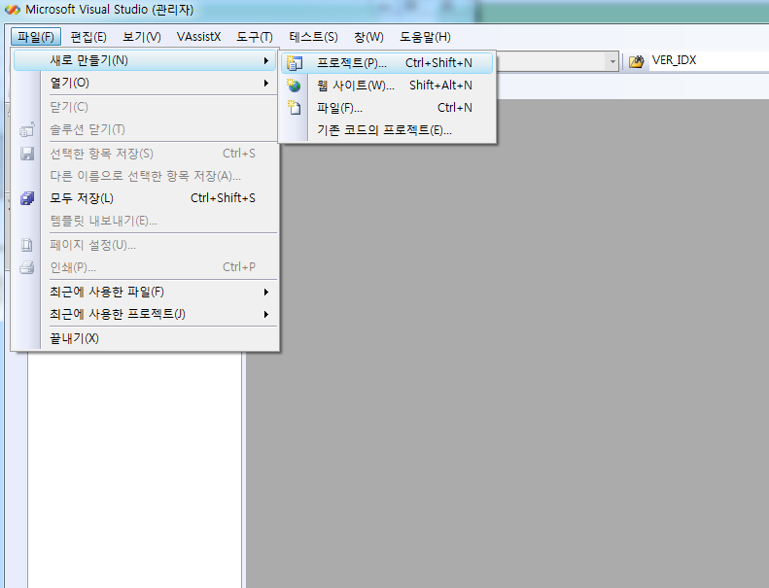
프로젝트 생성 과정

Slide 10
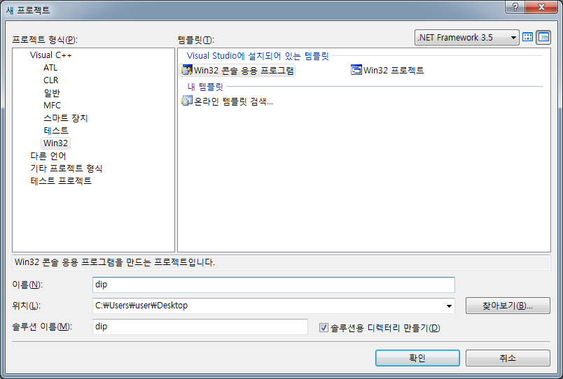

Slide 11
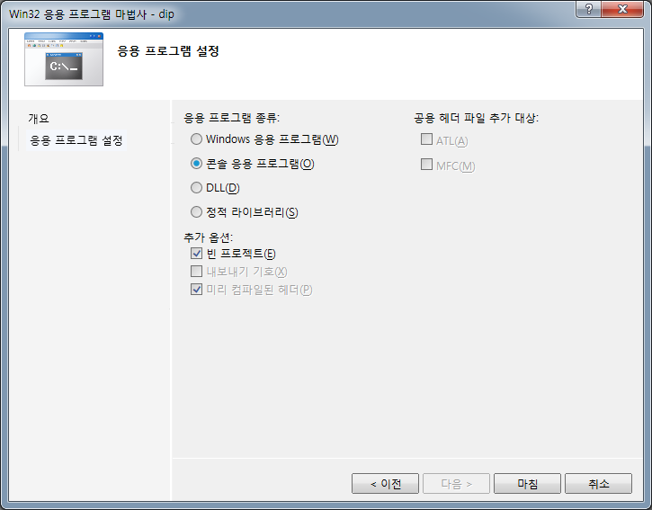

Slide 12
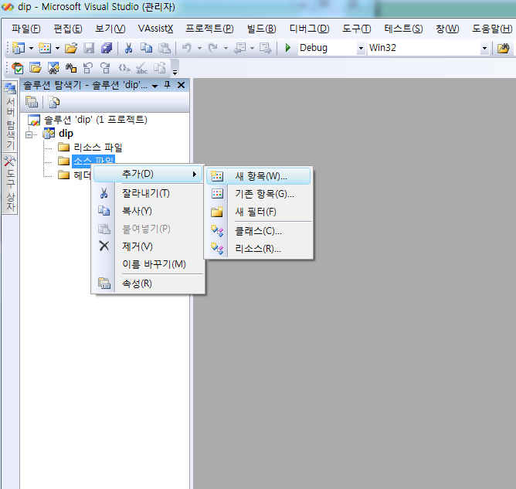

Slide 13
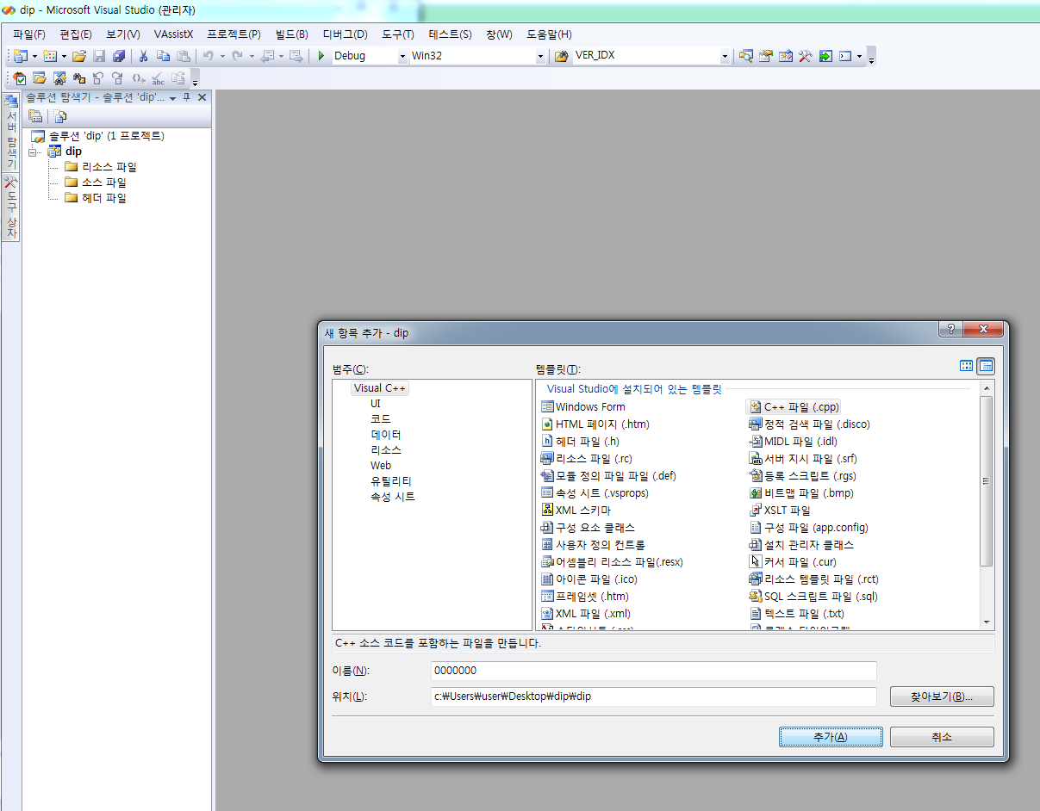

Slide 14
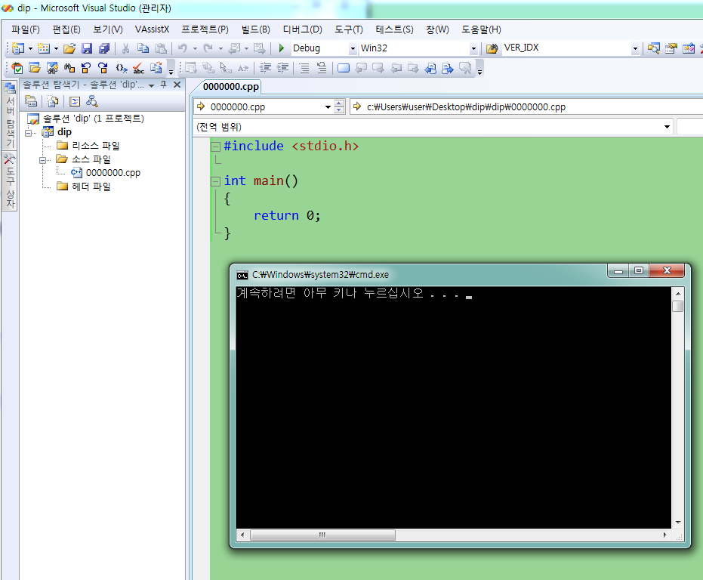

Slide 15
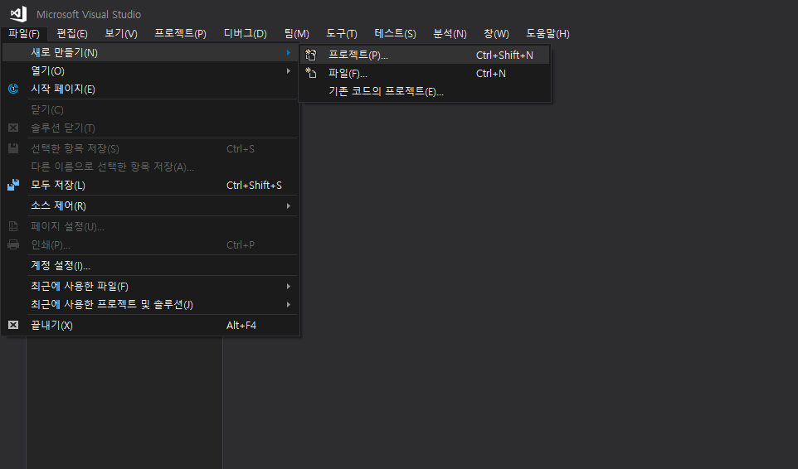
프로젝트 생성 과정 (2017 ver.)

Slide 16
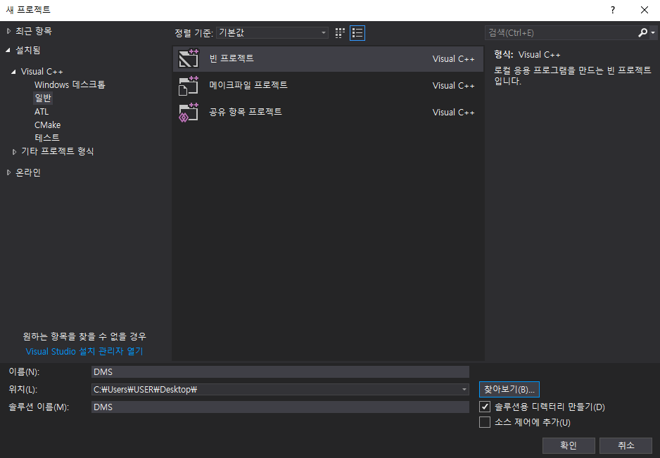

Slide 17
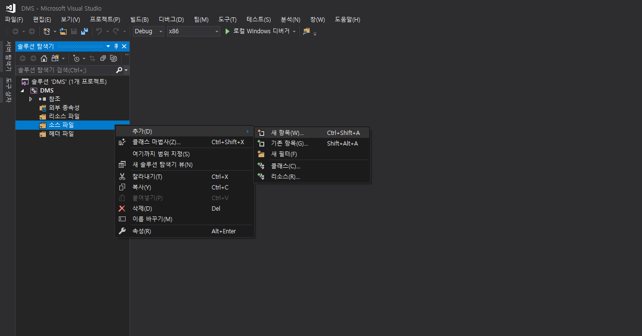

Slide 18
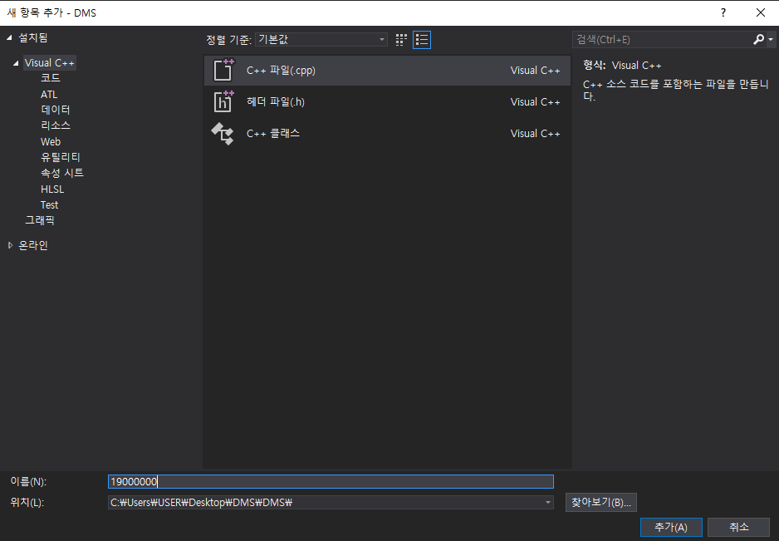
학번

Slide 19
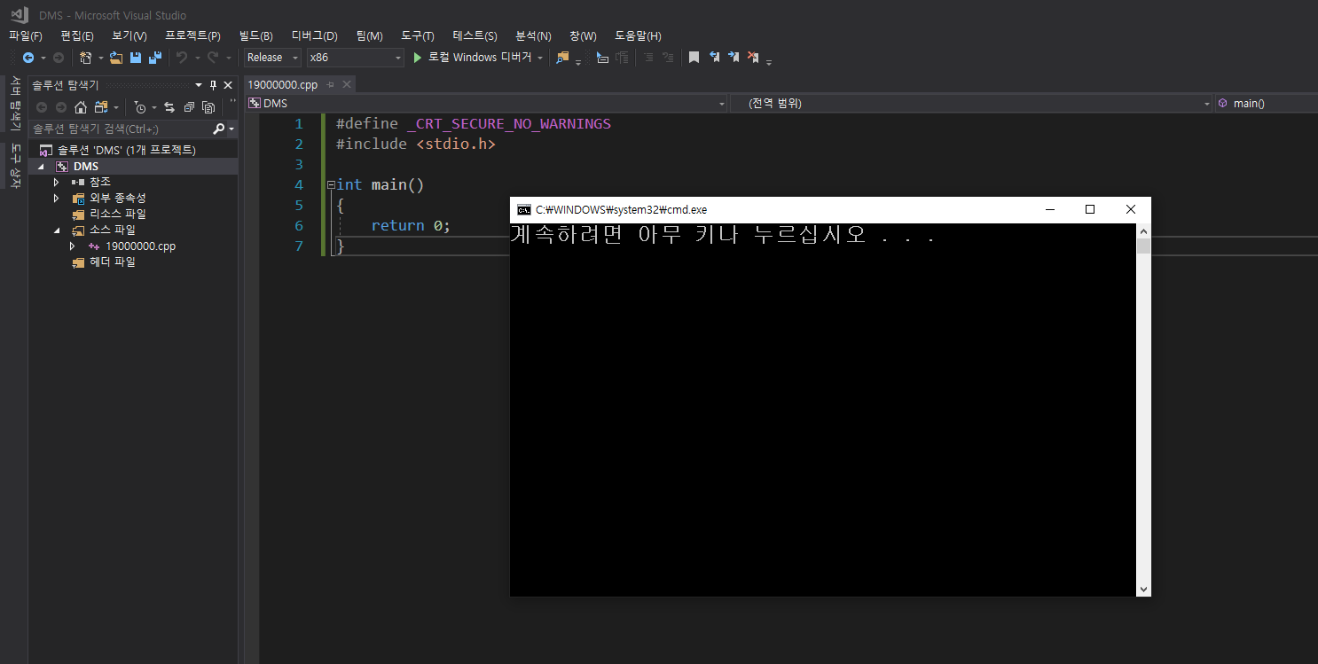

Slide 20
결과물 제출 (집현시스템 과제)
Output을 전부 bitmap으로 만들어서 zip하여 제출
결과 output_n.bmp file들과 code_n.cpp file들을 하나의 학번-이름.zip 으로 제출 (n=1,2,…,k번)
반드시 windows에서 제공하는 zip으로 제출 (모르는 version의 zip은 사용하지 말 것)

Slide 21
Function
메모리 동적 할당 및 해제
C : malloc(), free();
C++ : new, delete;
파일 입출력
파일 열기/생성 : fopen()
파일 닫기 : fclose()
파일 읽기 : fread()
파일에 데이터 쓰기 : fwrite()

Slide 22
File I/O function (ANSI C)
FILE *fopen(const char *filename, const char *mode);
ex) #include<stdio.h>
FILE *fp;
fp=fopen(“lena.img”,”rb”);
……………
fclose(fp);
fp=fopen(“out.img”,”wb”);
……………
fclose(fp);
fread(void *ptr, size_t size, size_t n, FILE *stream);
ex) fread(a,sizeof(unsigned char),512*512,fp);
fwrite(const void *ptr, size_t size, size_t n, FILE *stream);
ex) fwrite(b,sizeof(unsigned char),512*512,fp);

Slide 23
1-D Memory Allocation (C)
#include<stdlib.h>
void *malloc(size_t size);
free(void * block);
Ex) unsigned char *a;
a=(unsigned char*)malloc(sizeof(unsigned char)*512*512);
…..
// processing
…..
free(a);

Slide 24
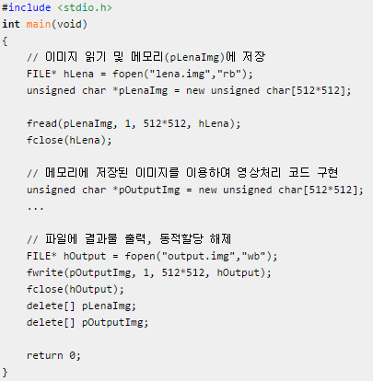
1-D memory allocation (C++)
예제코드

Slide 25
Basic 2-D Memory allocation
a[512][512]
unsigned char*
0
1
2
3
4
510
511
0
unsigned char**
1
2
510
511

Slide 26
Basic 2D Memory Allocation in C
# 2-Dimensional malloc() and image read
#include<stdio.h>
#include<math.h>
ex) unsigned char **a; //since image is 2D data
a=(unsigned char**)malloc(sizeof(unsigned char*)*512); //Height
for(i=0;i<512;i++)
a[i]=(unsigned char*)malloc(sizeof(unsigned char)*512);
fp=fopen(“lena.img”,”rb”);
for(i=0;i<512;i++)
fread(a[i],sizeof(unsigned char),512,fp);
// Do operation like Convolution, DFT,…..a[i][j] processing
………………………………………………………………
for(i=0;i<512;i++)
free(a[i]);
free(a);
C

Slide 27
Advanced 2-D memory allocation in C
unsigned char*
0
1
2
510
511
unsigned char**
0
1
2
510
511

Slide 28
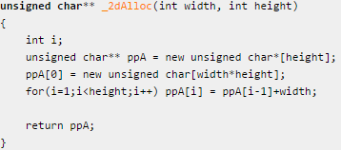
Advanced 2-D memory allocation
2차원 배열 할당 예제 (http://codeng.tistory.com/8 참조)
C++
typedef uint8 unsigned char
typedef uint32 unsigned int
unsigned char** memory_alloc2D(int height, int width)
{
unsigned char** ppMem2D = 0;
int j, i;
// array of pointer
ppMem2D = (unsigned char **)malloc(sizeof(unsigned char *)* height);
*ppMem2D = (unsigned char *)malloc(sizeof(unsigned char)*(width*height));
for (j=1; j< height; j++ ) ppMem2D[j] = ppMem2D[j-1] + width;
return ppMem2D;
}
C

Slide 29
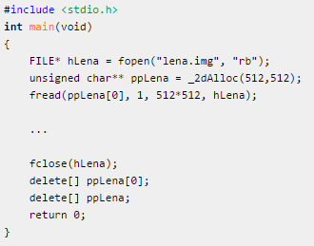
Memory Allocation
2차원 배열을 이용한 파일 입출력 예제
C++

Slide 30
example
typedef uint8 unsigned char
typedef uint32 unsigned int
uint8** memory_alloc2D(uint32 height, uint32 width)
{
uint8** ppMem2D = 0;
uint32 j, i;
// array of pointer
ppMem2D = (uint8**)calloc(sizeof(uint8*), height);
if ( ppMem2D == 0 )
return 0;
*ppMem2D = (uint8*)calloc(sizeof(uint8), width * height );
if( (*ppMem2D) == 0 )
{
// free the memory of array of pointer
free( ppMem2D );
return 0;
}
for (j=1; j< height; j++ )
{
ppMem2D[j] = ppMem2D[j-1] + width;
}
return ppMem2D;
}
C
int memory_free2D(uint8** ppMemAllocated)
{
if (ppMemAllocated == 0 )
{
return -1;
}
free( ppMemAllocated[0] );
free( ppMemAllocated );
return 0;

Slide 31
Image read/write fuction (ANSI C)
int main(void)
{
FILE* fpInputImage = 0;
FILE* fpOutputImage = 0;
uint8** ppInputImageBuffer= 0;
fpInputImage = fopen(IMG_NAME, "rb"); // input file open
// memory allocaiton
ppInputImageBuffer = memory_alloc2D(IMG_HEIGHT, IMG_WIDTH);
// input file read to memory from the file
fread( &ppInputImageBuffer[0][0], sizeof(uint8), IMG_WIDTH*IMG_HEIGHT, fpInputImage);
fpOutputImage = fopen("result.img", "wb"); // output fileopen
//processing
// write the file
fwrite( &ppInputImageBuffer[0][0], sizeof(uint8), IMG_WIDTH*IMG_HEIGHT, fpOutputImage);
memory_free2D(ppInputImageBuffer);
fclose(fpInputImage);
fclose(fpOutputImage);
return 0;
}

Slide 32
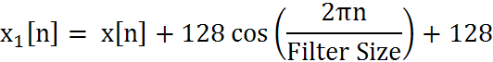
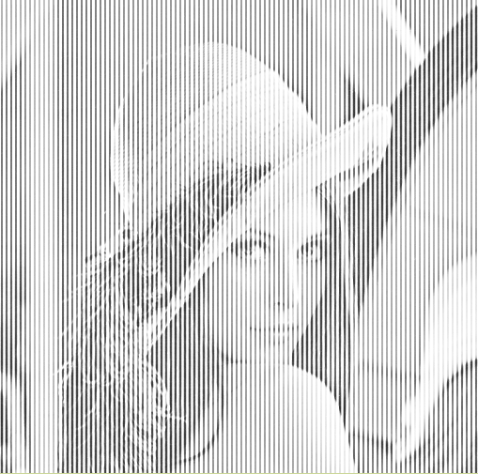
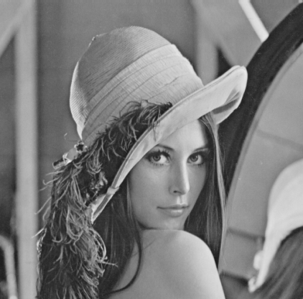
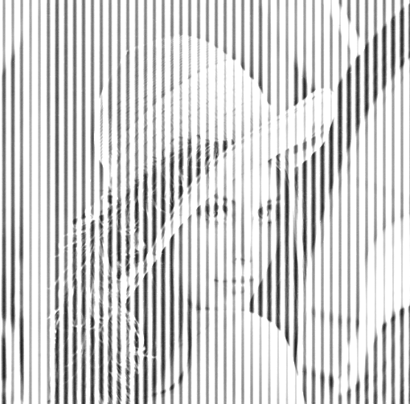
Experiment – Add noise
Distorted by adding a cosine noise signal plus a constant
filter size : 7 filter size : 11
output_1.bmp, code-1.c
2023-12-01

Slide 33
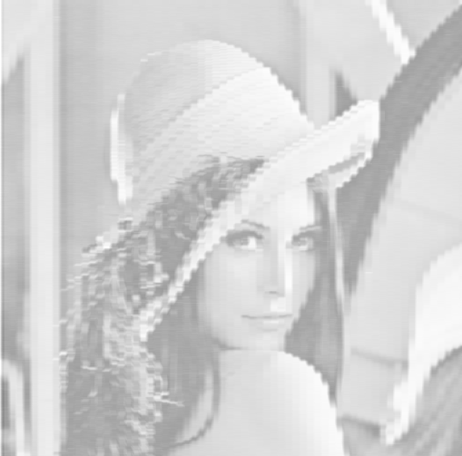
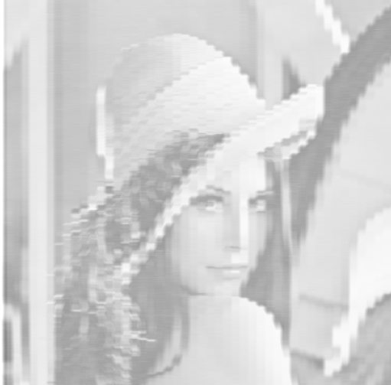

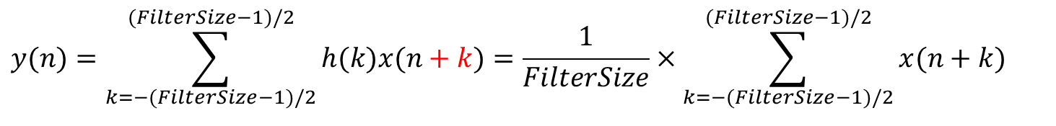
Experiment – Remove noise
Lowpass Averager (1D Filtering): convolution in CNN FilterSize : 7 FilterSize : 11
$$y(n)=\sum_{k=−(FilterSize−1)/2}^{(FilterSize−1)/2}{h(k)x(n+k)}=\frac{1}{FilterSize}×\sum_{k=−(FilterSize−1)/2}^{(FilterSize−1)/2}{x(n+k)}$$
output_2.bmp, code-2.c
2023-12-01

Slide 34
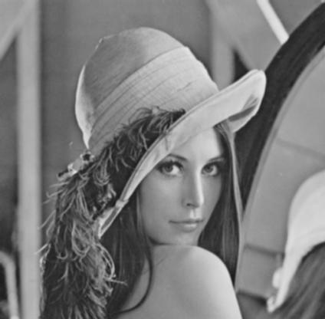
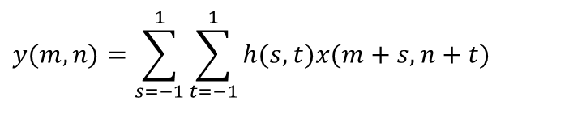
Low-pass filtering (Spatial Filtering)
$$y(m,n)=\sum_{s=−1}^{1}{\sum_{t=−1}^{1}{h(s,t)x(m+s,n+t)}}$$
Average filter:
1 | 1 | 1
1 | 1 | 1
1 | 1 | 1
1/9
Put the average value
h[m,n]
: Current
sample
: neighbor
sample
: Filtered sample
output_3.bmp, code-3.c
2023-12-01

Slide 35
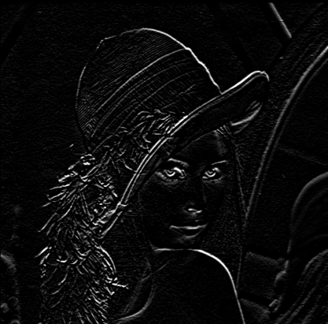
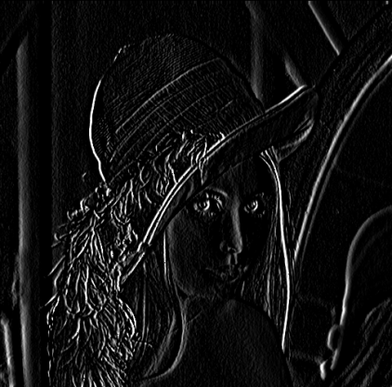
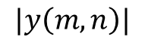
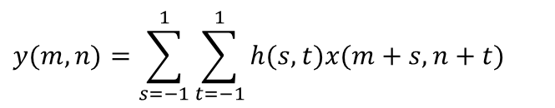
High-pass filtering
$$y(m,n)=\sum_{s=−1}^{1}{\sum_{t=−1}^{1}{h(s,t)x(m+s,n+t)}}$$
Sobel operator:
+1 | +2 | +1
0 | 0 | 0
-1 | -2 | -1
+1 | 0 | -1
+2 | 0 | -2
+1 | 0 | -1
output_4.bmp, code-4.c
$$|y\left(m,n\right)|$$
< Horizontal edge >
< Vertical edge>
2023-12-01

Slide 36
2-D LPF vs. HFP
1) h[m,n] 2) h[m,n]
1 | 1 | 1
1 | 1 | 1
1 | 1 | 1
+1 | +2 | +1
0 | 0 | 0
-1 | -2 | -1
1/9
C 마 C++ 1개의 code로 output 4개의 결과를 보여도 됨
output_1.bmp, output_2.bmp, output_3.bmp, output_4.bmp,
code-A.c

